Slide 1
https://github.com/nuitrcs/rdm-for-coding​

Slide 2


Data management for computational research
Project organization, file formats, tidy data
Instructor: Tobin Magle, PhD
Date: July 6, 2023
Materials: https://github.com/nuitrcs/rdm-for-coding

Slide 3
Description:
Did you know that good data management practices can make computational research easier? Learning how to code can be challenging, but many common mistakes made by novice programmers can be avoided by using good data management practices. This workshop will cover how to make your computational projects readable by both humans and computers by organizing the script and data files in your project and formatting tabular data so that it can be easily read by R packages and Python libraries.

Slide 4
Data* Management
How you store, organize, and document your work so it's understandable and reusable **.
* can extend to documents, code, notes, etc
** by you and others

Slide 5

Goal: "I can walk away from the project and come back to it a year later and resume work fairly quickly"

Slide 6
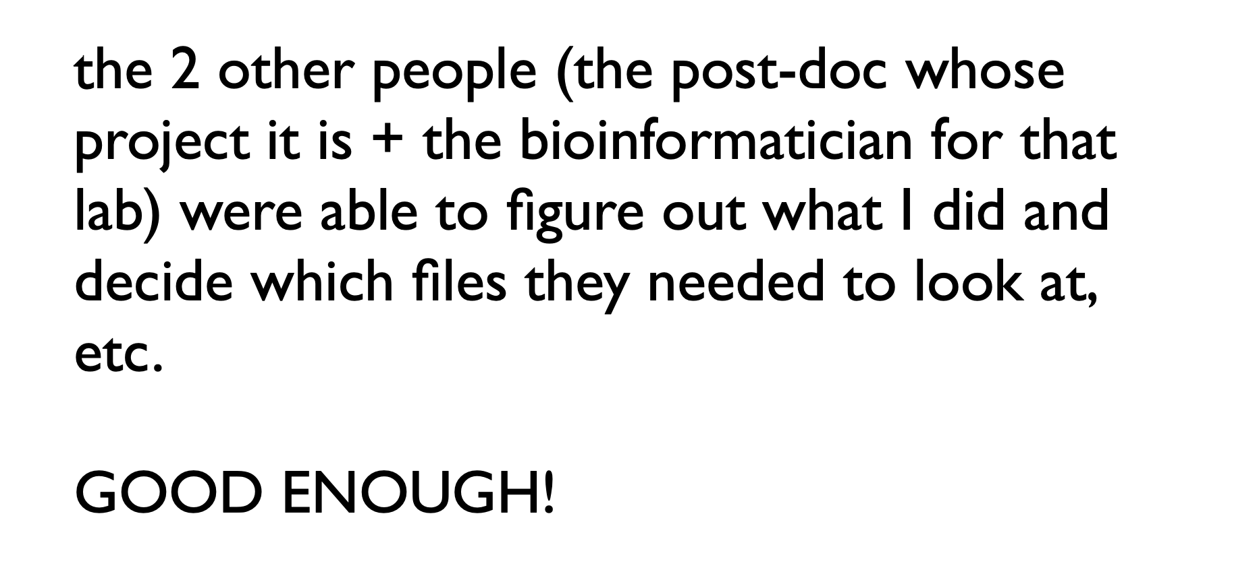
Real life R example
Jenny Bryan, RStudio Developer
http://www2.stat.duke.edu/~rcs46/lectures_2015/01-markdown-git/slides/organization-slides/organization-slides.pdf

Slide 7
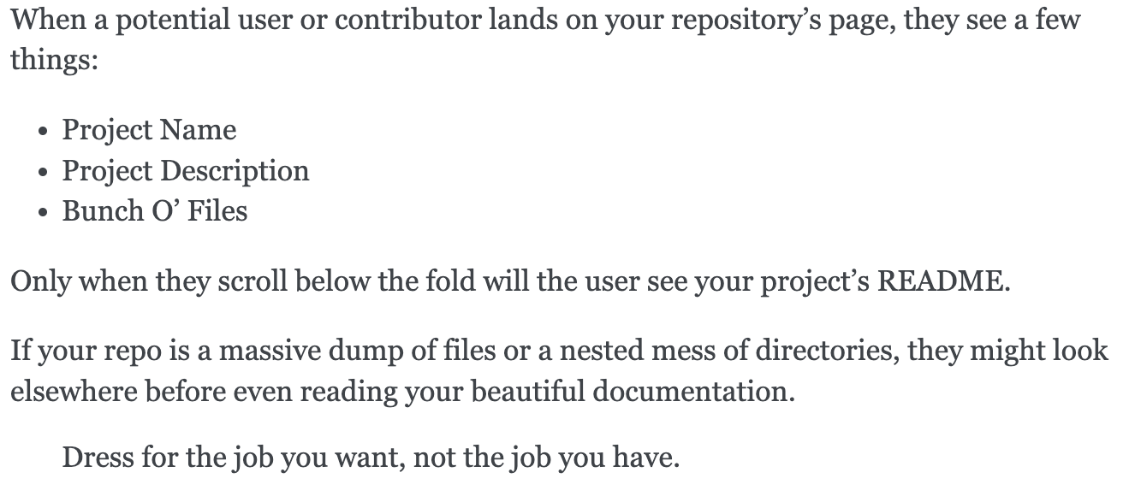
Real life Python example
- Hitchhikers Guide to Python
https://docs.python-guide.org/writing/structure/

Slide 8
Topics
Choosing data storage
Creating a strategy for project organization your project
Balancing human readability and machine readability
Making your work reproducible and reusable

Slide 9




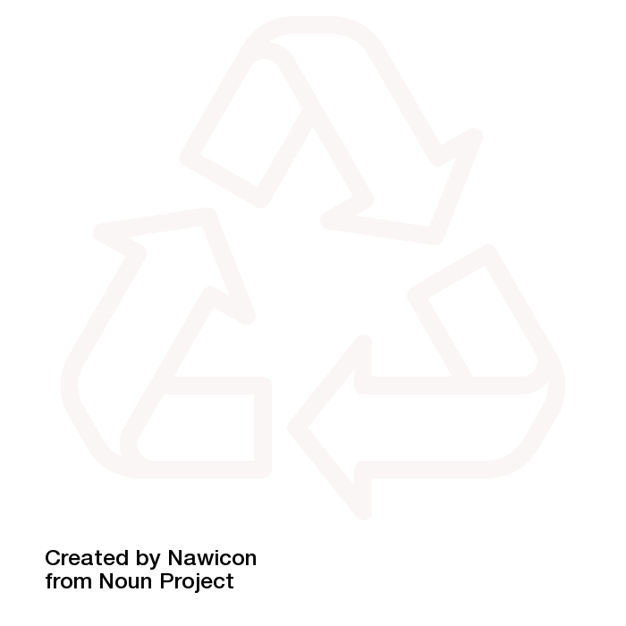
Topics
Choosing Storage
Organizing your project
Human vs machine readability
Making it reusable

Slide 10
Data storage where to store it depends on what you want to do with it

Slide 11
Places to store your data
Active Data Storage
Sharing with collaborators
Quest Storage
Your computer
SharePoint
Research Data Storage Service (RDSS)
OneDrive
NAS
Google Drive
FSMResfiles
Hard Drives
Public Cloud Storage:
Amazon Web Service
Microsoft Azure
Google Cloud Platform
Archival Data Storage
Sharing publicly
Arch
Dryad

Slide 12
Choosing data storage
Security: Is your data "legally or contractually restricted"? What requirements must be satisfied?

Slide 13
HIPAA
No
Maybe
Yes
Active Data Storage
Sharing with collaborators
Quest Storage
Your computer
SharePoint
Research Data Storage Service (RDSS)
OneDrive
NAS
Google Drive
FSMResfiles
Hard Drives
Public Cloud Storage:
Amazon Web Service
Microsoft Azure
Google Cloud Platform
Archival Data Storage
Sharing publicly
Arch
Dryad

Slide 14
Choosing data storage
Security: Is your data "legally or contractually restricted"? What requirements must be satisfied?
Volume: How much data do you have? Where will it fit? How much will it cost?

Slide 15
No Extra Cost Options
No
Maybe
Yes
Active Data Storage
Sharing with collaborators
Quest Storage
Your computer
SharePoint
Research Data Storage Service (RDSS)
OneDrive
NAS
Google Drive
FSMResfiles
Hard Drives
Public Cloud Storage:
Amazon Web Service
Microsoft Azure
Google Cloud Platform
Archival Data Storage
Sharing publicly
Arch
Dryad

Slide 16
Capacity limits
Platform | OneDrive | SharePoint | GoogleDrive | Dryad
Total Capacity | 5 TB/user | 25 TB/site | Unlimited* | 300 GB/ submission
Individual file size | 250 GB | 250 GB | 5 TB | 10 GB
Number of files | 30,000,000/ user | 30,000,000/site | 500,000/folder | none
Movement | 250 GB or 10,000 files download |  | 750 GB/ day upload | NA
*Not for long

Slide 17
Choosing data storage
Security: Is your data "legally or contractually restricted"? What requirements must be satisfied?
Volume: How much data do you have? Where will it fit? How much will it cost?
Durability: Does your data storage back it up for you?

Slide 18
Storage that has backups
Active Data Storage
Sharing with collaborators
Quest Storage
Your computer
SharePoint
Research Data Storage Service (RDSS)
OneDrive
NAS
Google Drive
FSMResfiles
Hard Drives
Public Cloud Storage:
Amazon Web Service
Microsoft Azure
Google Cloud Platform
Archival Data Storage
Sharing publicly
Arch
Dryad

Slide 19
Choosing data storage
Security: Is your data "legally or contractually restricted"? What requirements must be satisfied?
Volume: How much data do you have? Where will it fit? How much will it cost?
Durability: Does your data storage back it up for you?
Access: Who needs access to your data? What level?

Slide 20
Access
Platform | Quest | RDSS | SharePoint | GoogleDrive | Dryad
Who can get access? | Anyone with a Quest account | Anyone with a NetID | Anyone with Microsoft account | Anyone with Google account | Everyone (public)
Types of access | Whole project, permissions can be edited by file/folder | Whole Share | Whole library, By file or folder | By file/folder | public
Permissions | read/write/ execute | read only or read/write | View, edit or review | View, edit, comment | Read only

Slide 21
Choosing data storage
Security: Is your data "legally or contractually restricted"? What requirements must be satisfied?
Volume: How much data do you have? Where will it fit? How much will it cost?
Durability: Does your data storage back it up for you?
Access: Who needs access to your data? What level?
Workflow: Where is the data produced? Where do you analyze it?

Slide 22
Data workflows
Make sure your data is accessable to your compute
or
Have a plan to move it

Slide 23
Compute Sources
Compute Source | Where to store data | Comments
Your computer | Your hard drive | Might not be big enough Needs a backup
 | External drive | Might not be fast enough
 | Network Drive (RDSS) | Might not be fast enough
Quest | Quest storage | Only option Needs a backup location
"The Cloud" | In the cloud | Pay per use Moving data out costs $$

Slide 24
Tool: Globus
Quest Storage
Designed for large file transfer
Transfer and sync data between "collections"
Many NU storage systems
Your computer
More to come this fall
Error handling
Research Data Storage Service (RDSS)
SharePoint
OneDrive
FSMResfiles
Amazon S3
Your computer

Slide 25
Globus connected
Active Data Storage
Sharing with collaborators
Quest Storage
Your computer
SharePoint
Research Data Storage Service (RDSS)
OneDrive
NAS
Google Drive
FSMResfiles
Hard Drives
Public Cloud Storage:
Amazon Web Service
Microsoft Azure
Google Cloud Platform
Archival Data Storage
Sharing publicly
Arch
Dryad

Slide 26
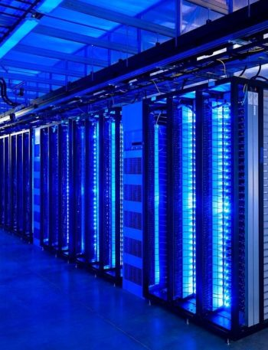
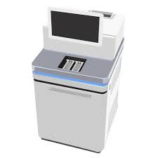

Example Workflow
Instrument
Quest Storage
SharePoint
?
You're using data produced at a core facility. ​
You need to analyze it on Quest, then transfer the results to SharePoint to collaborate on a paper​

Slide 27
Direct to Quest
Instrument
Quest Storage
SharePoint

Slide 28
Direct to Quest
Instrument
Quest Storage
SharePoint
Core facility won't keep your data
Quest Storage is not backed up

Slide 29

Via your computer
Instrument
Your computer
Quest Storage
SharePoint
Notes:
Considerations:
The core isn't going to store your data for you long term
You need to store the data temporarily on Quest to run your analysis, but Quest storage isn't backed up
What are your options for intermediate storage? For this example, we're assuming you have to pick between transferring it to your laptop or your computer.
Both could use Globus to get to Quest
RDSS is in the same data center as Quest – transfer will be faster – better backup and versioning
Your computer – comfortable, but probably slower network and greater risk of data loss

Slide 30
Via your computer
Instrument
Your computer
Quest Storage
SharePoint
Is your computer backed up regularly?
What happens if your hard drive dies?
How fast is your internet connection?
Notes:
Considerations:
The core isn't going to store your data for you long term
You need to store the data temporarily on Quest to run your analysis, but Quest storage isn't backed up
What are your options for intermediate storage? For this example, we're assuming you have to pick between transferring it to your laptop or your computer.
Both could use Globus to get to Quest
RDSS is in the same data center as Quest – transfer will be faster – better backup and versioning
Your computer – comfortable, but probably slower network and greater risk of data loss

Slide 31
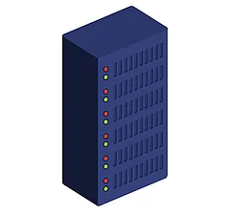
Via RDSS/FSMResfiles
Instrument
RDSS
Quest Storage
SharePoint
Notes:
Considerations:
The core isn't going to store your data for you long term
You need to store the data temporarily on Quest to run your analysis, but Quest storage isn't backed up
What are your options for intermediate storage? For this example, we're assuming you have to pick between transferring it to your laptop or your computer.
Both could use Globus to get to Quest
RDSS is in the same data center as Quest – transfer will be faster – better backup and versioning
Your computer – comfortable, but probably slower network and greater risk of data loss

Slide 32
Via RDSS/FSMResfiles
Instrument
RDSS
Quest Storage
SharePoint
Data is backed up
Daily snapshots
Connected to Quest by fast network

Slide 33
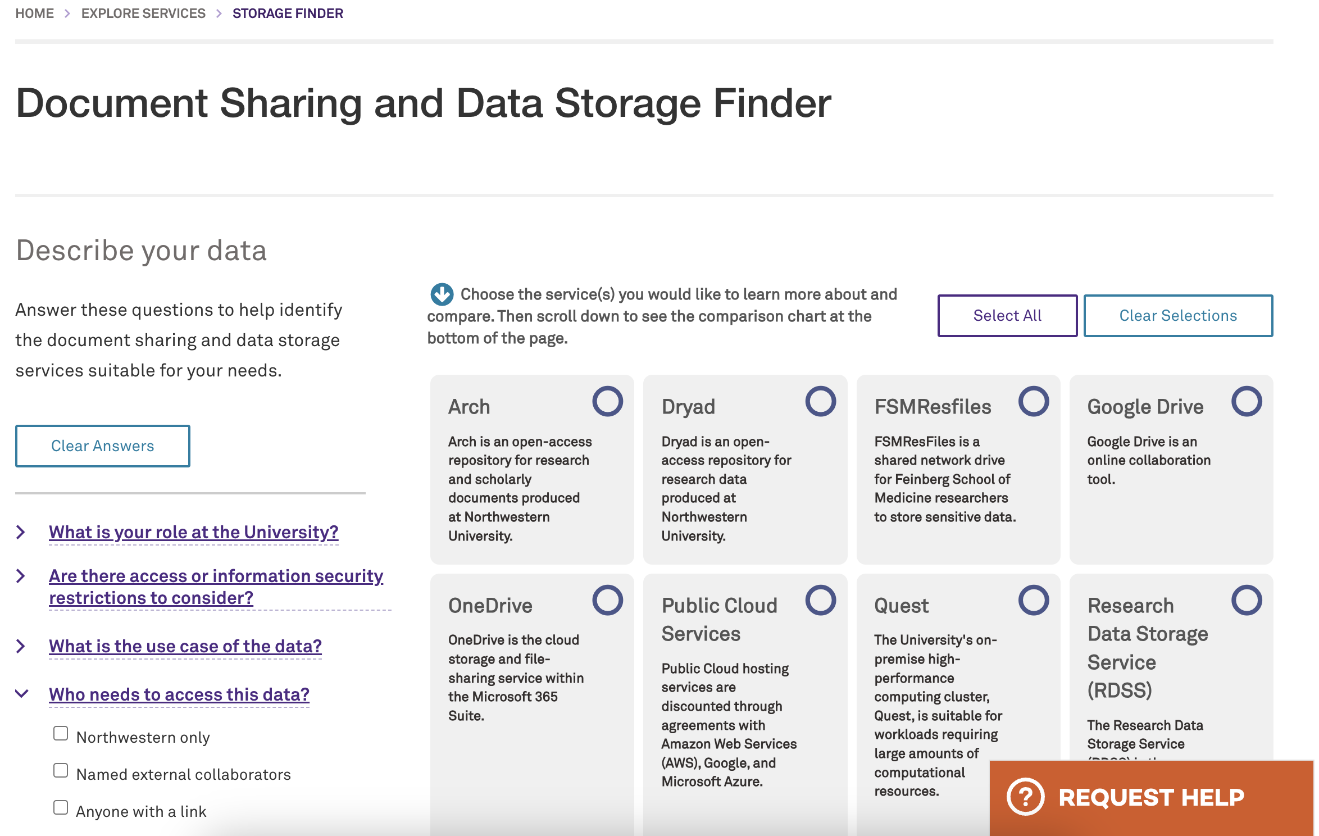
Finding data storage at Northwestern
https://www.it.northwestern.edu/services/storage-finder/

Slide 34
Topics
Choosing Storage
Organizing your project
Human vs machine readability
Making it reusable

Slide 35
Organization Takes time up front Saves time and frustration later Based on material from https://kbroman.org/

Slide 36
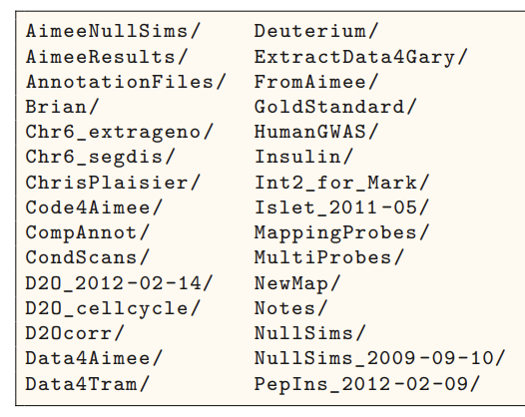
Good Organization Practices
Goal: Avoid Chaos​
Put everything for a project in one folder
Create a subfolder for each file type
Use descriptive names (more on this later)
Make a README (more later)
https://kbroman.org/Tools4RR/assets/lectures/06_org_eda_withnotes.pdf

Slide 37
Example Basic Project
my_project/
code/
data/
raw_data/
processed_data/
Main project folder
Files by type
Subfolders
output/

Slide 38
Example Paper Project
my_paper/
data/
raw_data/
processed_data/
Main project folder
Files by type
Subfolders
tables/
code/
output/
figs/

Slide 39
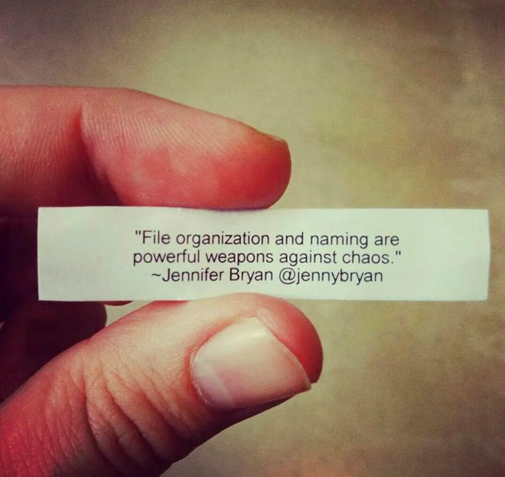
Project Organization Advice
There's no one right answer
Make a system that works for you
Be consistent!
Stick to it
Examples in R, python and bash
https://github.com/moldach/project-directory

Slide 40
Topics
Choosing Storage
Organizing your project
Human vs machine readability
Making it reusable

Slide 41
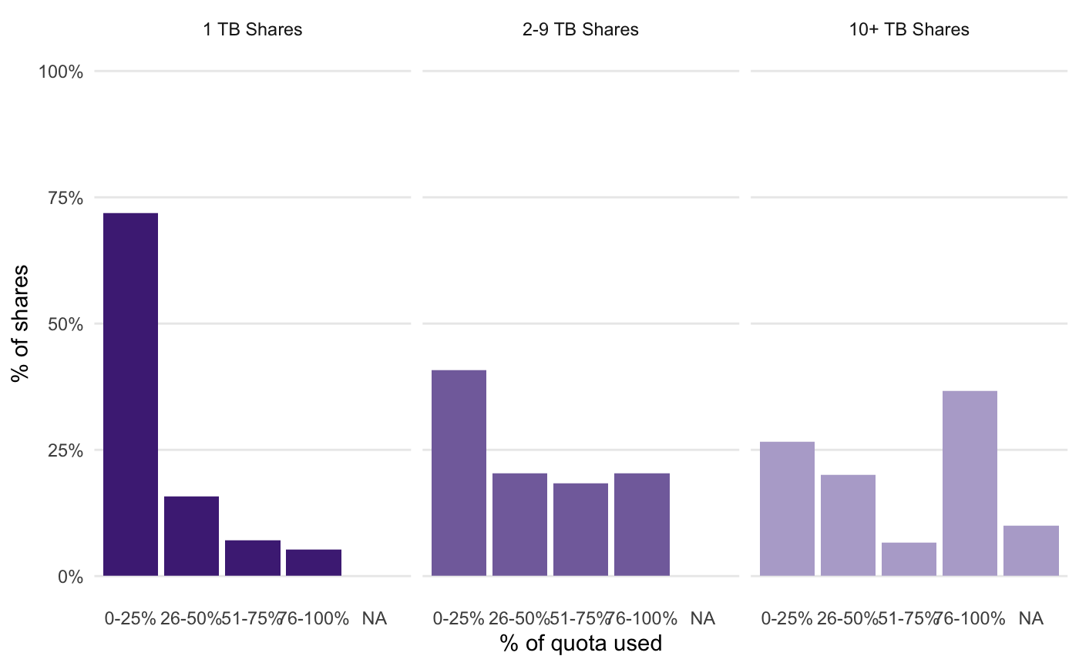
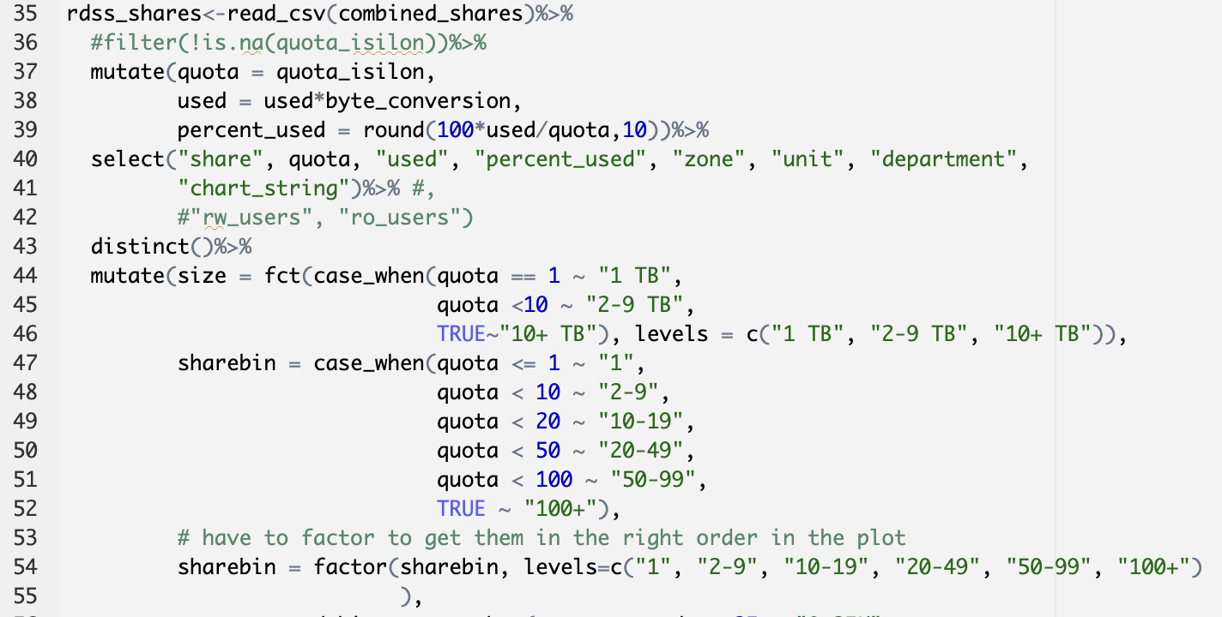
Human vs. Machine readability
Machine readable
Human Readable

Slide 42
Goal: Make your project...
Color coding
Pretty pictures
Full sentences
human readable
AND
machine readable
Good file names
Tidy data
Binary code
Tabular data

Slide 43
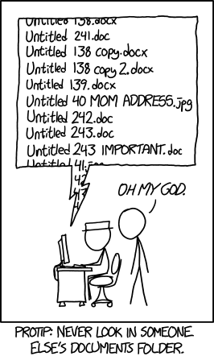
File naming
Programs do not produce good default names
Bad file names can waste time
Create a file naming convention that works for you and stick to it

Slide 44
File naming
Programs do not produce good default names
Bad file names can waste time
Create a file naming convention that works for you and stick to it

Slide 45
Good file naming practices
Use descriptive names
No spaces in file names
Limit special characters in file names
Be consistent
Use existing standards
Use sort to your advantage

Slide 46
Use descriptive names
Not specific
script.R
document 1.txt
script.txt
notes.md
Specific
clean-the-data.R
references.txt
outlier-analysis.py
README.md
Names should tell you what's in the file
Non-specific names don't help you or the computer
Use appropriate file extensions
Make sure to include information that differentiates files

Slide 47
Spaces in file names
$ ls
file 1.txt file2.txt
$ ls file 1.txt
ls: 1.txt: No such file or directory
ls: file: No such file or directory
$ ls file2.txt
file2.txt
$
Human readable, but..
Computers use spaces as a delimiter
Replace with _ or -

Slide 48
Limit special characters
Characters have special meanings to operating systems use
Don't confuse your OS
Ex: bash
Underscore (_) and dash (-) are ok
Character | Meaning
# | Comment
$ | Variable expression
& | Background job
* | Wildcard
( ) | Groups commands
; | Separates commands
' or " | Quotes phrases
/ | Pathname directory separator
? | Single-character wildcard
! | Pipeline logical NOT
https://www.oreilly.com/library/view/learning-the-bash/

Slide 49
Be consistent
Make it easy to find the information you need
Things to check for consistency: dates, capital letters, order, abbreviations
Use existing standards
Inconsistent
2023-07-05-geo-Chicago.csv
Chicago-June2023-Geospatial.csv
July22-23-Austin-geo.csv
Austin-July-2023-income.csv
Consistent
07-23-Chicago-geospatial.csv
06-23-Chicago-geospatial.csv
07-23-Austin-geospatial.csv
07-23-Austin-income.csv

Slide 50
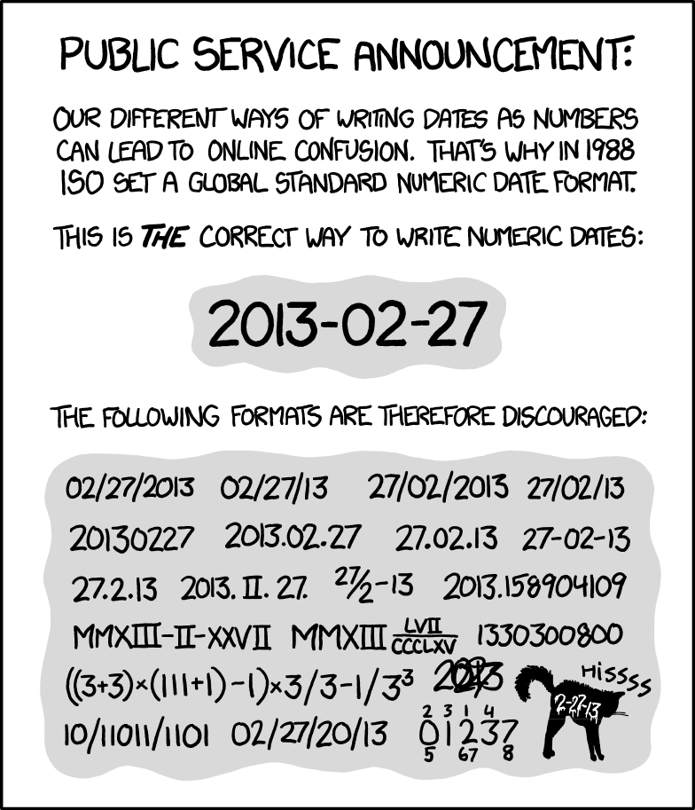
Use existing standards
Dates!
What do other people in your research group do?
What do people in your field do?
https://xkcd.com/1179/

Slide 51
Use sort to your advantage
Your computer is good at sorting
Name your files so it sorts them in a useful way
General to specific
Not useful
06-23-Chicago-geospatial.csv
07-23-Austin-Geospatial.csv
07-23-Austin-income.csv
07-23-Chicago-geospatial.csv
Useful
2023-06-geospatial-Chicago.csv
2023-07-geospatial-Chicago.csv
2023-07-geospatial-Austin.csv
2023-07-income-Austin.csv

Slide 52
File naming advice
Name your files so you know what it is before you open it
Don't use spaces and special characters
Pick a convention and stick to it

Slide 53
Tidy Data
Tidy datasets are easy to manipulate, model and visualize
Many reasons
Different collection methods
Inconsistent units
Human error
Cleaning takes a lot of time
Tidy datasets are all alike but every messy dataset is messy in its own way.
-Hadley Wickham

Slide 54
Tidy data structure
Each variable forms a column.
Each observation forms a row.
Each type of observational unit forms a table.
https://vita.had.co.nz/papers/tidy-data.pdf

Slide 55
Common problems
Multiple variables in one column​
Variables spread across rows
Variables spread across columns​
Mixing observational units in a table
Spreading an observational unit across tables.​
https://vita.had.co.nz/papers/tidy-data.pdf

Slide 56
Multiple Variables in a column
Monitoring birds in local parks
Observation: one bird
Variables: park, date, bird
Bird = species + sex
Can't analyze species and sex separately
park | date | bird
Penny | 2023-07-04 | Cardinal-M
Penny | 2023-07-04 | Cardinal-F
James | 2023-07-05 | Cardinal-M
James | 2023-07-05 | Sparrow-F
James | 2023-07-05 | Sparrow-M
James | 2023-07-05 | RWBB-F

Slide 57
Multiple Variables in a column
Solution
Make a column for each variable
park | date | species | sex
Penny | 2023-07-04 | Cardinal | M
Penny | 2023-07-04 | Cardinal | F
James | 2023-07-05 | Cardinal | M
James | 2023-07-05 | Sparrow | F
James | 2023-07-05 | Sparrow | M
James | 2023-07-05 | RWBB | F

Slide 58
Variables spread across rows
Measuring pet weight and height at a vet clinic
Observation: 1 pet
2 rows per pet
How do we fix it?
Name | species | variable | value
Tybalt | cat | weight | 5
Madden | dog | weight | 4
Tybalt | cat | height | 3
Madden | dog | height | 5
https://vita.had.co.nz/papers/tidy-data.pdf

Slide 59
Variables spread across rows
Solution
Move unique values in 'variable' to column headers
Move values to corresponding cells
Name | species | height | weight
Tybalt | cat | 3 | 5
Madden | dog | 5 | 4
https://vita.had.co.nz/papers/tidy-data.pdf

Slide 60
Variables spread across columns
Experiment with 3 treatments and 3 replicates
Good for compactness
Human readable
Can't analyze the replicates together
Treatment | 1 | 2 | 3
control | 0 | 1 | 0.5
A | 5 | 6 | 4
B | 4 | 3 | 1
https://vita.had.co.nz/papers/tidy-data.pdf

Slide 61
Variables spread across columns
treatment | replicate | value
control | 1 | 0
A | 1 | 5
B | 1 | 4
control | 2 | 1
A | 2 | 6
B | 2 | 3
control | 3 | 0.5
A | 3 | 4
B | 3 | 1
Solution
Add a column for "replicate" (variable)
Pivot the values into one column

Slide 62
Mixing observational units
Measuring pet weight over time
Duplicates information (owner, species)
Not a problem until you get into really big data
day | owner | name | species | weight
1 | Toby | Tybalt | cat | 8.0
1 | Arden | Madden | dog | 30.3
7 | Toby | Tybalt | cat | 8.1
7 | Arden | Madden | dog | 28.5
14 | Toby | Tybalt | cat | 8.2
14 | Arden | Madden | dog | 29.8

Slide 63
Mixing observational units
owner | name | species
Toby | Tybalt | cat
Arden | Madden | dog
Solution
Make 2 tables:
Pet table
Weight table
Foundation of creating relational databases
day | name | weight
1 | Tybalt | 8.0
1 | Madden | 30.3
7 | Tybalt | 8.1
7 | Madden | 28.5
14 | Tybalt | 8.2
14 | Madden | 29.8

Slide 64
Splitting observational units
Measuring pet weight over time
Day 1
name | weight
Tybolt | 8.0
Madden | 30.3
Splitting up data by variable categories or by time
Intuitive, but inefficient
Harder to catch inconsistencies
D7
name | weight
Tybalt | 8.1
Maddan | 28.5
Day 14
name | wt
Tybalt | 8.2
Madden | 29.8

Slide 65
Splitting observational units
Solution
Make sure format is consistent across tables
Combine into 1 dataset
day | name | weight
1 | Tybalt | 8.0
1 | Madden | 30.3
7 | Tybalt | 8.1
7 | Madden | 28.5
14 | Tybalt | 8.2
14 | Madden | 29.8

Slide 66
Column Names
Column headers become variable names
Human readable: Aim for descriptive name
Avoid abbreviations
Machine readable: Avoid spaces and most special characters
Be consistent!
Naming convention | Example
Camel case | speciesName
Snake case | species_name
Kabob case | species-name
Dot case | species.name*
* Can cause issues in Python with pandas

Slide 67
How can we improve this table?
Measuring animal weight by sex and species
Date collected | plot | Species-sex | Weight
Jan 9, 1978 | 1 | DM-M | 40
1/9/1978 | 1 | DM-F | 36 g
1/9/78 | 1 | DS-F | 135
1/20/78 | 2 | DM-M | 38g
1/20/78 | 2 | DS-f | .144 kg
03/13/1978 | 2 | DM-F | 44
3/13/78 | 2 | DS-F | 146
Is each column a separate variable?
Is each value in the column the same format
Can a computer read the column headers?
Notes:
Let's take a look at this table. How can we make its columns more easily computer readable?

Slide 68
Structural Changes
Use consistent header format
Make a column for each variable
date_collected | plot | species | sex | weight
Jan 9, 1978 | 1 | DM | M | 40
1/9/1978 | 1 | DM | F | 36 g
1/9/78 | 1 | DS | F | 135
1/20/78 | 2 | DM | M | 38g
1/20/78 | 2 | DS | f | .144 kg
03/13/1978 | 2 | DM | F | 44
3/13/78 | 2 | DS | F | 146
Notes:
First, let's look at the structure of the folumns
we can choose and apply a consistent naming convention for the columns.
Also, splitting species and sex into two columns will help analysis

Slide 69
Content Changes
Make sure codes for male/female are consistent
Use a consistent format within columns
Make sure weights are numbers
date_collected | plot | species | sex | weight_g
1/9/1978 | 1 | DM | M | 40
1/9/1978 | 1 | DM | F | 36
1/9/1978 | 1 | DS | F | 135
1/20/1978 | 2 | DM | M | 38
1/20/1978 | 2 | DS | F | 144
3/13/1978 | 2 | DM | F | 44
3/13/1978 | 2 | DS | F | 146

Slide 70
Topics
Choosing Storage
Organizing your project
Human vs machine readability
Making it reusable

Slide 71
Reusability You mostly collaborate with yourself, and me-from-two-months-ago never responds to email.
- @mtholder

Slide 72
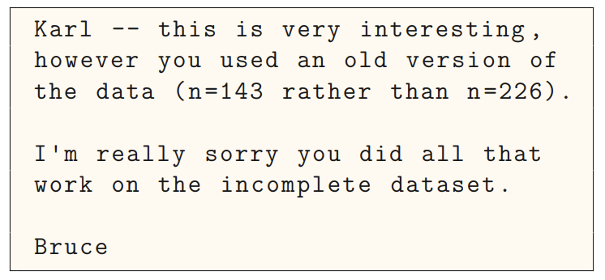
The results in Table 1 don’t seem to correspond to those in Figure 2.
“Your script is now giving an error.”
How did I make that figure?
In what order do I run these scripts?
Where did we get this data file?
“The attached is similar to the code we used.”​​​
Which image goes with
which experiment?​​​
Why did I omit those samples?
Adapted from https://www.biostat.wisc.edu/~kbroman/presentations/steps2rr.pdf

Slide 73
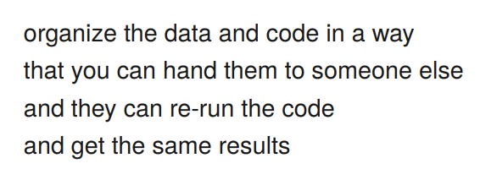
Basic: Make it reproducible
Automation
Keep the raw data raw
Documentation
README / code books
Portability
File paths
Version control
- @kbroman

Slide 74
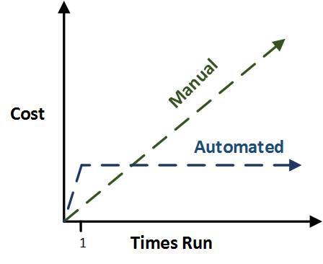
Automate everything
(even the things that take longer to code than if you did it by hand)
It's really hard to document things you do by hand
Don't touch the raw data – mark as read only
Write code that cleans the data and makes any output you need
Then you have a pipeline for when you get another similar file

Slide 75
What goes in a README file?
Tell you-from-6-months-ago how to use the project
Context: How the data was produced
Data inventory: list of files and folders and what they contain
Codebook: Describe the contents of data files
Instructions: how to use the code and data together

Slide 76
What goes in a Codebook?
Describe the contents of data files
What variables measure
What type is it?
Units and any other format (dates, geographic coordinates)
Define valid data range and missing values

Slide 77
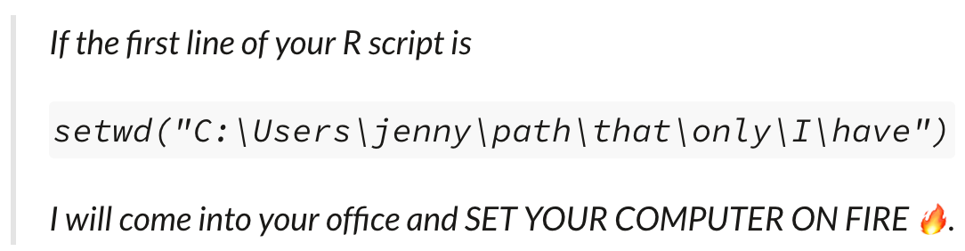
Portability
Will your code work for someone else?
Do you use file paths only you have?
Are all the components you need to run the code in one folder?
https://www.tidyverse.org/blog/2017/12/workflow-vs-script/

Slide 78
Version control
Show how you got from A to B
By hand: Save As
file naming
V1,V2 etc
Dates
Never "Final"
Takes precision
Creates so many files
Formal: Version control system (Git)
Unlimited undo
Creates an ID for each "commit"
Good for collaboration (who did what when)
Steep learning curve
Versions hidden behind latest

Slide 79
Reusability Advice
A little bit reusable is better than nothing
Keep the raw data raw – read only
Document what is there
Use self-contained projects
Use version control

Slide 80
Choosing Storage
Organizing your project
Human vs machine readability
Making it reusable
Think about your workflow + back it up.
Keep it all in one place + be consistent.
Names + data structure are important.
Automate + document everything.

Slide 81
Questions?

Slide 82
References
Organization by Jenny Bryan for the Reproducible Science Workshop at Duke University
Structuring your project by Kenneth Reitz and Tanya Schlusser in the Hitchhiker's Guide to Python
Document Sharing and Data Storage Finder from Northwestern IT
Tools for reproducible research by Karl Broman from https://kbroman.org/
Best Practices for Data Science Project Workflows and File Organization by Matthew Oldach
Naming things by Jenny Bryan for the Reproducible Science Workshop
Tidy data by Hadley Wickham in the Journal of Statistical Software (2014) 59(10), 1–23
Steps Toward Reproducible Research by Karl Broman from https://kbroman.org/
Project-oriented workflow by Jenny Bryan from tidyverse.org blog

Slide 83
Thank You

